Slide 1
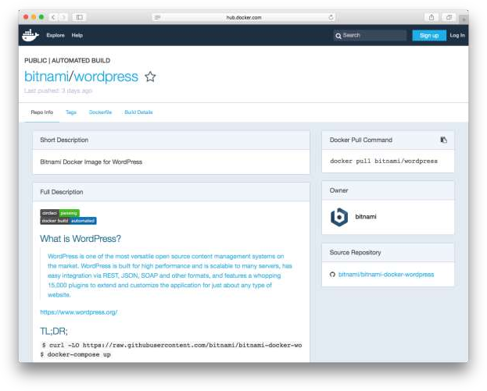

Slide 2



Kubernetes
Production-Grade Container Orchestration Platform
Integrates with GCE, AWS, Azure, OpenStack, etc. Backed by a large open source community

Slide 3
Cloud-Native Architecture
MariaDB
Database tier
WordPress
Backend tier
Nginx
Frontend tier

Slide 4
Cloud-Native Architecture
Service
resource
Secret
resource
Deployment
resource
MariaDB
Database tier
Service
resource
Config Map
resource
Deployment
resource
WordPress
Backend tier
Service
resource
Deployment
resource
Nginx
Frontend tier

Slide 5
Example: Kubernetes resource
apiVersion: v1 kind: Deployment metadata:
name: wordpress spec:
replicas: 1 template:
metadata: labels:
app: wordpress spec:
containers:
- name: wordpress
image: bitnami/wordpress:4.7-r0 ports:
- containerPort: 80 livenessProbe:
httpGet: path: / port: http
initialDelaySeconds: 120
timeoutSeconds: 5

Slide 6
Example: Deploying to Kubernetes
$ kubectl create -f ./mariadb-secret.yaml
secret "mariadb" created
$ kubectl create -f ./mariadb-deployment.yaml
deployment "mariadb" created
$ kubectl create -f ./mariadb-service.yaml
service "mariadb" created
$ kubectl create -f ./wordpress-configmap.yaml
configmap "wordpress" created
$ kubectl create -f ./wordpress-deployment.yaml
deployment "wordpress" created
$ kubectl create -f ./wordpress-service.yaml
service "wordpress" created
$ kubectl create -f ./nginx-deployment.yaml
deployment "nginx" created
$ kubectl create -f ./nginx-service.yaml
service "nginx" created

Slide 7
Problems with Managing Resources
Boilerplate when developing manifests
No history
for releases
Upgrades and configuration changes
require manual editing
Need tooling to hook
into release lifecycle
Difficult to share publicly or with members of your team

Slide 8

Need a tool to manage a group of
resources as a single unit

Slide 9

Package Manager for Kubernetes

Slide 10
Are
application definitions
Consist of...
Charts
(packages)
Metadata
Kubernetes resource definitions Configuration File
Documentation

Slide 11

Navigating a Chart
Metadata Documentation Config File
Service
resource
Secret
resource
Deployment
resource
MariaDB
Database tier
Service
resource
Secret
resource
Deployment
resource
WordPress
Backend tier
Service
resource
Deployment
resource
Nginx
Frontend tier

Slide 12
Grab Helm on GitHub or Homebrew
$ brew cask install helm

Slide 13
Getting Started is Simple
$ helm init
$ helm repo add bitnami http://charts.bitnami.com

Slide 14
Init in Action
https://goo.gl/PyW0wO

Slide 15
Install Charts
https://goo.gl/fWw8Lm

Slide 16
Upgrade a Release
https://goo.gl/lChu5T

Slide 17






























Slide 18




Why Bitnami Charts?
Optimized images for
Kubernetes deployments
Apps kept up-to-date with
Bitnami's automated toolchain
A consistent experience, in
containers, charts, VMs, etc.
Images kept secure against
major vulnerabilities

Slide 19
bitnami.com/kubernetes

